Slide 1
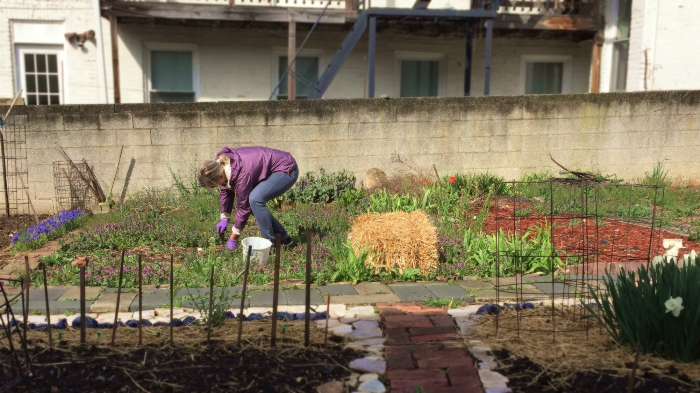


Safe Urban Harvests
Study Overview and Preliminary Results
January 9, 2018
Keeve Nachman, PhD, MHS

Slide 2
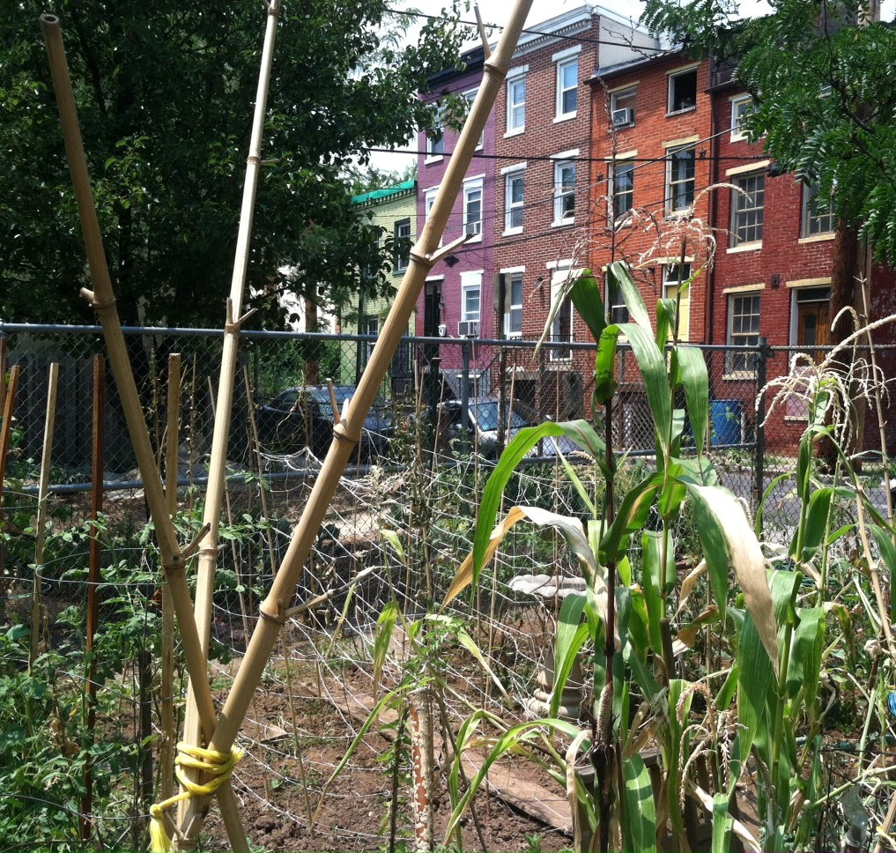

Overview
Motivation
Aims
Methods
Preliminary results
Survey
Water

Slide 3
Overview
Motivation
Aims
Methods
Preliminary results
Survey
Water

Slide 4
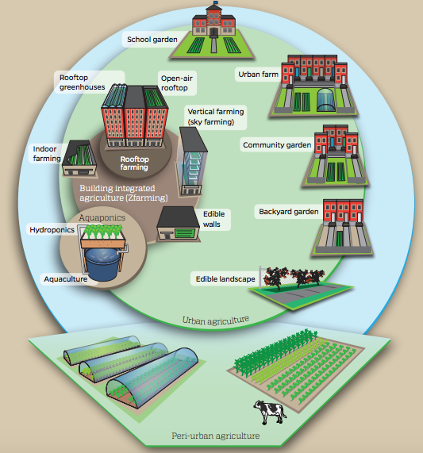
Urban agriculture
Urban agriculture: production of food and non-food plants, plus animal husbandry, in urban areas
  Gardening
    Backyard gardening
    Rooftop gardening
    Community gardening
  Farming
    Crop production
    Livestock production
    Fungiculture
    Hydroponics and aquaponics
    Vertical farming
  Urban foraging
Graphic: Mike Milli, CLF

Slide 5
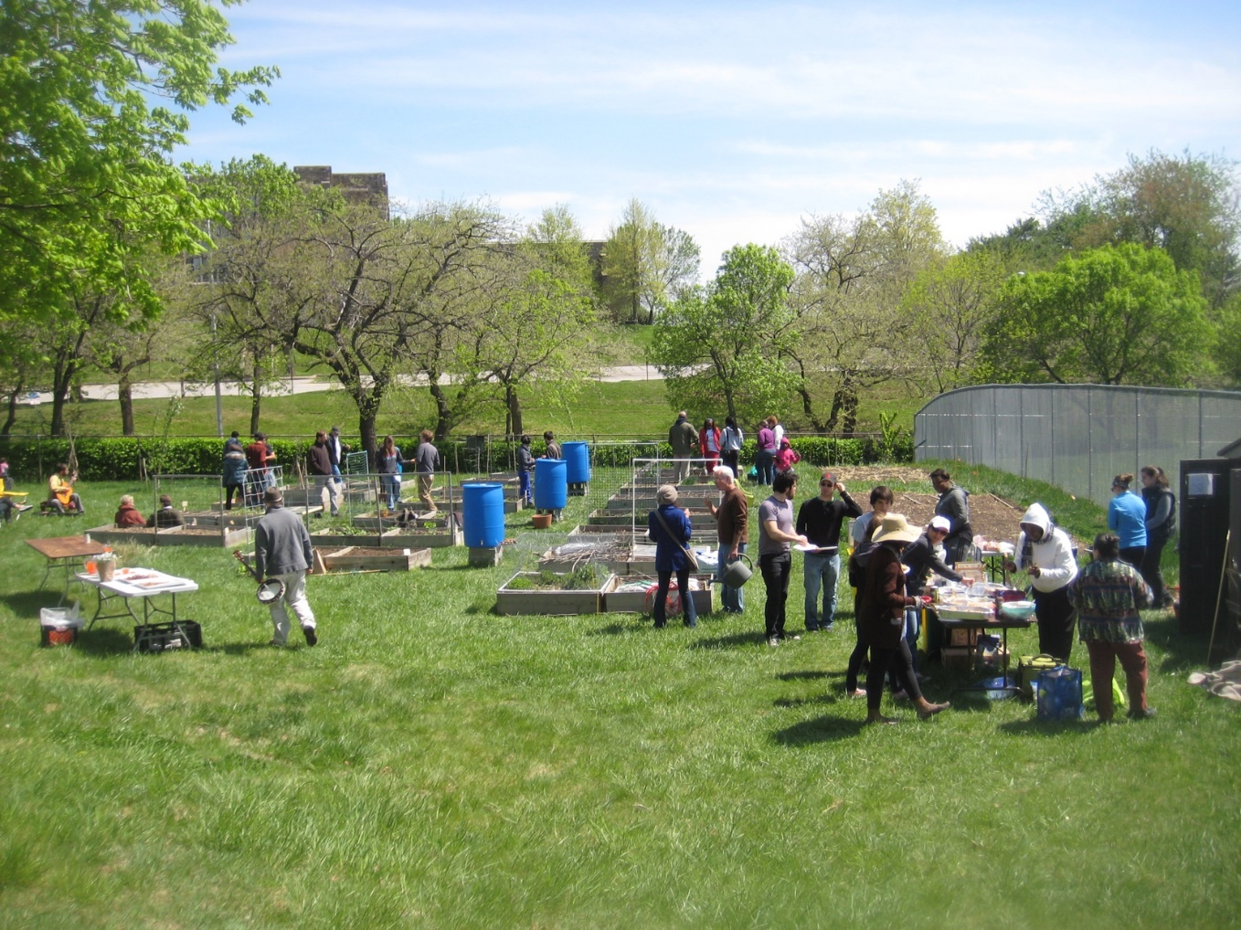
Potential benefits of urban agriculture
Social/community
  Increases social cohesion
  Offers opportunities for expression and maintenance of cultural heritage
  Reduces crime rates
  Provides educational opportunities
  May catalyze civic and political engagement
Health
  Can support participants’ physical and psychosocial health
  Supplements household, community and municipal food security, and may offer resilience to temporary food shortages
Photo Credit: Ruth Burrows
Santo, R., Palmer, A., & Kim, B. (2016). Vacant Lots to Vibrant Plots: A Review of the Benefits and Limitations of Urban Agriculture. Baltimore: Johns Hopkins Center for a Livable Future.

Slide 6
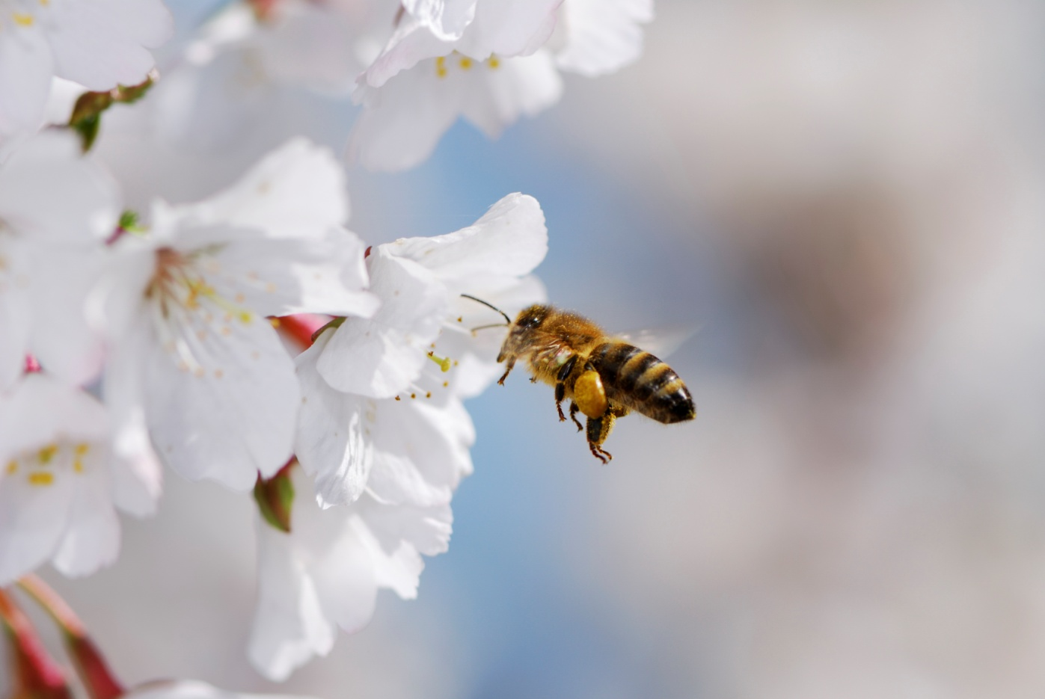
Potential benefits of urban agriculture
Environmental
  Air filtration
  Storm water retention
  Habitats and forage for beneficial species
  Moderation of urban heat island effect
Economic development
  Increased property values
  Large-scale job creation potential not demonstrated, but provides opportunities for skills development, workforce training, and supplemental income generation
Photo Credit: Thinkstock (manfredxy)
Santo, R., Palmer, A., & Kim, B. (2016). Vacant Lots to Vibrant Plots: A Review of the Benefits and Limitations of Urban Agriculture. Baltimore: Johns Hopkins Center for a Livable Future.

Slide 7
Impacts of urban agriculture vary by type
Open outdoor plot
Greenhouses (ground)
Building-integrated
  e.g. non-profit community garden
  Social/community benefits
  Education opportunities
  May provide economic savings and culturally-relevant food to participants
  Inefficient use of inputs + lower yields + limited seasonality → low production potential
  e.g. for-profit farm with greenhouses
  Job training opportunities for local residents
  More efficient + higher yields + (in heated greenhouses) year-round seasonality → larger production potential
  e.g. vertical farms, hydroponics, rooftop greenhouses
  More efficient + higher yields + year-round seasonality → larger production potential
  Higher capital requirements, and in some cases, inputs like energy and water
Santo, R., Palmer, A., & Kim, B. (2016). Vacant Lots to Vibrant Plots: A Review of the Benefits and Limitations of Urban Agriculture. Baltimore: Johns Hopkins Center for a Livable Future.
Notes:
We must be careful to remember that, as previously discussed, urban agriculture occurs in many different forms and that its potential benefits are not attributed equally across all models.

Slide 8
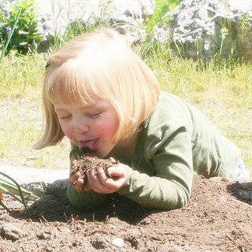
Health risks
Potential soil contaminants:
  Heavy metals (e.g., lead, arsenic, cadmium, chromium)
  Other chemicals (e.g., VOCs, PAHs, PCBs)
  Other hazards (e.g., building materials, foreign objects, biological hazards)
Potential forms of exposure:
  Skin contact
  Inhalation
  Ingestion
    Contaminants on plant surfaces
    Contaminant bioaccumulation in plant tissues
    Incidental ingestion of soil

Slide 9
Perceived risks and concerns
In 2012, we conducted a survey* of urban community gardeners' knowledge and perceptions of soil contaminant risks in Baltimore
  Surveyed 70 gardeners (15 gardens represented)
  While respondents generally indicated low levels of concern, we heard many questions about the safety of Baltimore’s soils and urban-grown produce
We decided to gather real-world evidence to help us speak to those concerns with greater confidence
* Kim, B. F., Poulsen, M. N., Margulies, J. D., Dix, K. L., Palmer, A. M., & Nachman, K. E. (2014). Urban community gardeners' knowledge and perceptions of soil contaminant risks. PLoS ONE, 9(2), e87913.

Slide 10
Overview
Motivation
Aims
Methods
Preliminary results
Survey
Water

Slide 11
Aims
Characterize urban farms and gardens in Baltimore City
Evaluate metals contamination of soil, irrigation water, and produce from Baltimore’s farms and community gardens
Model exposures and risks for persons growing and consuming urban produce
Compare to levels of heavy metals in supermarket and farmers market produce

Slide 12
Overview
Motivation
Aims
Methods
Preliminary results
Survey
Water

Slide 13
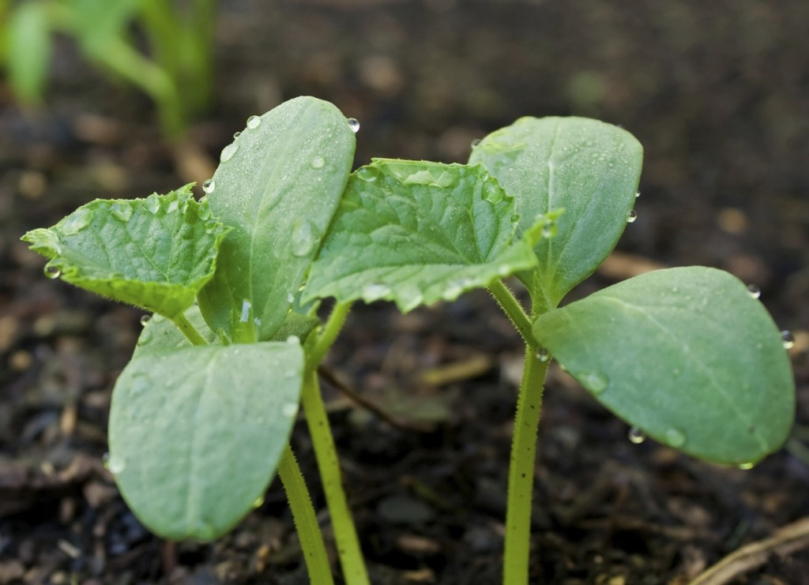
Methods overview
Partners
Recruitment
Survey
Sample collection
Data analysis

Slide 14
Study partners
Technical Partners
Sample analysis: USDA Agricultural Research Service, Adaptive Cropping Systems Laboratory
Sample analysis: Ana Rule’s lab at Johns Hopkins Bloomberg School of Public Health
Comparative case study: Emily Minor’s lab at University of Illinois at Chicago
Community Partners: recruitment, study design, results dissemination
Baltimore Office of Sustainability
Community Greening Resource Network
Farm Alliance of Baltimore City
University of Maryland Extension ⎯ Baltimore City

Slide 15

Recruitment
Recruited participants (beginning summer 2016) through community partner networks to complete survey
Additionally:
  scanned social media related to Baltimore urban ag
  surveyed Google maps
  conducted snowball sampling of participants
Incentives: free soil, water, and produce sampling (including broader metal test than offered in classic soil tests)

Slide 16

Study participants
145 farms/gardens identified as “eligible”:
  Within Baltimore city limits
  Not at house or school (exception: sampled schools that asked to participate, but did not actively recruit)
  Serving >1 family
  Growing food
112 participating sites (77% participation rate)
  Sampled additional 6 sites (total N=118) that are not yet growing food or just outside of city limits
Map of participating sites
Participating urban farm or garden
Notes:
Explain farm/garden issue – didn’t bother to define or separate out

Slide 17
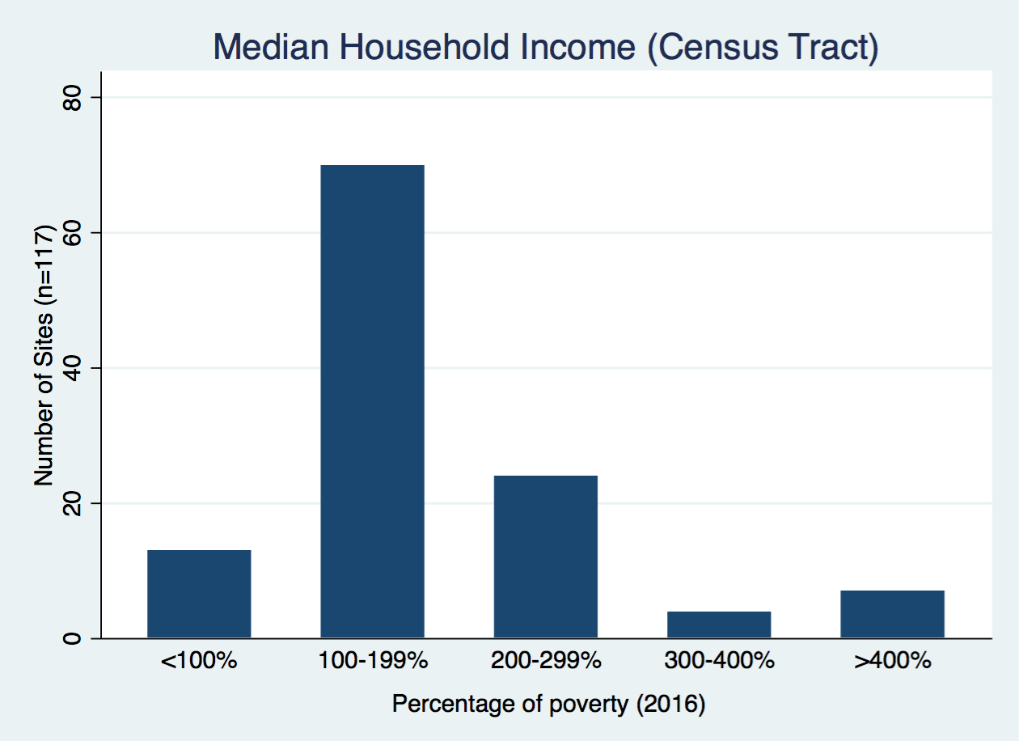
Socioeconomic status of participating site neighborhoods
2016 poverty level: $24,300 for family of four
Notes:
This figure represents 117 sites. Excluded one site because an estimate is not available due to insufficient data points in the ACS.

Slide 18
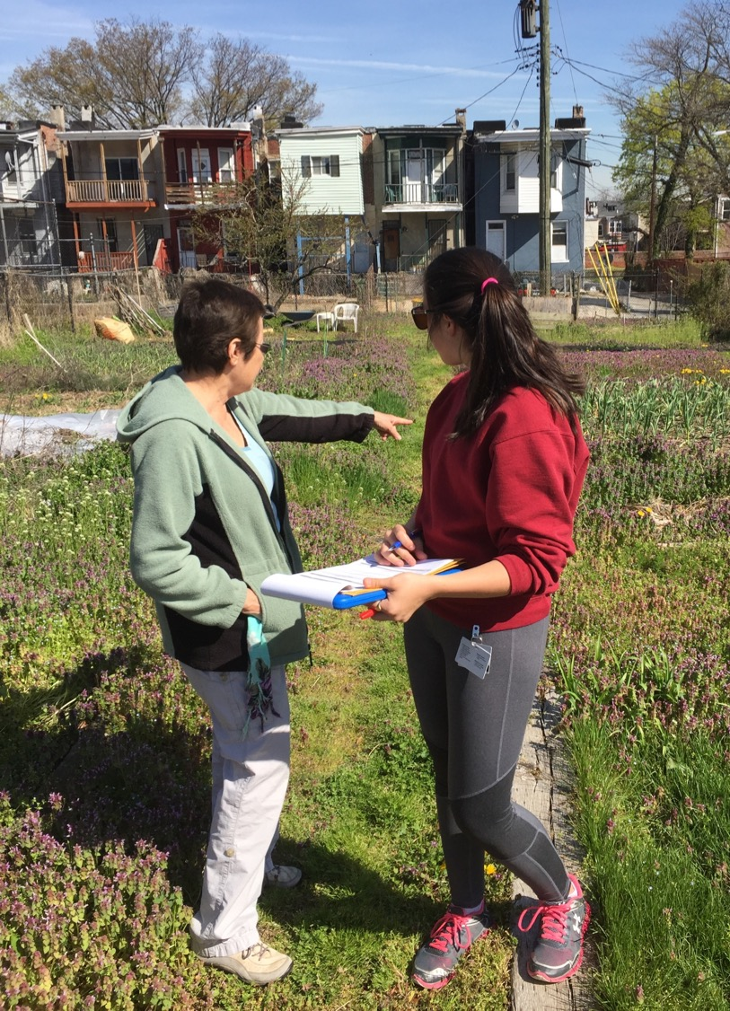
Survey
Distributed survey via phone or online (followed up if discrepancies found), occasionally on-site
Gathered data regarding:
  What is grown, how much, and production methods (including inputs)
  Who’s on site and what they do when they’re there
  Site histories
  Previous contaminant testing

Slide 19
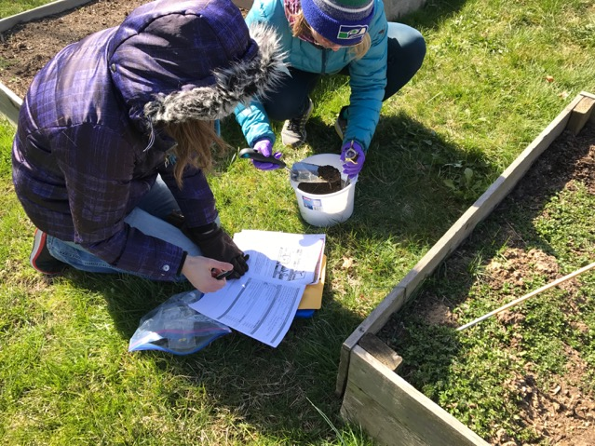
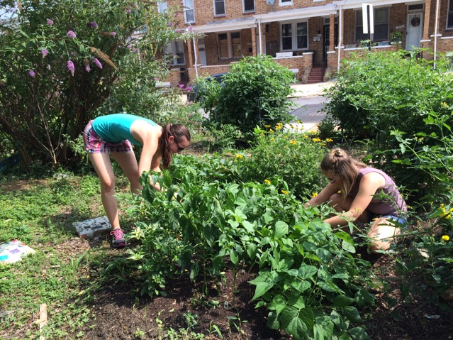
Timeline
Kick-off meeting with community partners
Recruitment begins
Soil and water sampling begins
Produce sampling begins
Goal: Return produce results
Sampling completed
2016
2017
2018
SUH Chicago begins
Goal: Return soil and water results

Slide 20
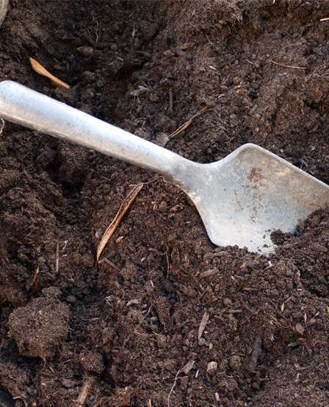
Soil and water sampling
291 growing area soil samples to be analyzed
  Includes duplicate samples of each growing area
  Repeat process composites collected at 23 (19%) sites
231 non-growing area soil samples to be analyzed
  two were collected per site (one heavily trafficked area, other native soil conditions)
235 irrigation water samples
  Includes municipal water and rain barrel samples, collected in duplicates
  Additional 10% blanks from field, and 10% from lab
17 compost samples

Slide 21
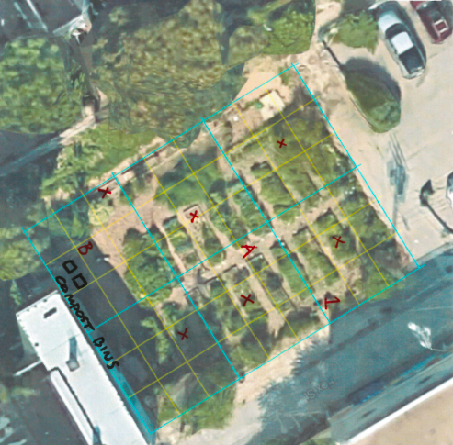
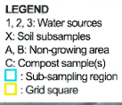
Soil sample collection
Growing area
  Collect soil subsamples of active growing areas to form composite soil sample. The number of necessary subsamples is determined by growing area size estimated from Google Maps (typically 6-8 subsamples/site)
  For each subsample:
    Prepare area by removing vegetation, rocks, debris
    Insert trowel 6” into soil and remove intact soil slice.
    Remove grass and thatch then add subsample to bucket
    Record subsample location on map (X)
  Mix subsamples to form composite soil sample and then fill 4-oz sample bag (collected in duplicates)
  For ~20% of sites, we collected another composite soil sample (“repeat process composite”) using same procedure but in slightly different areas

Slide 22
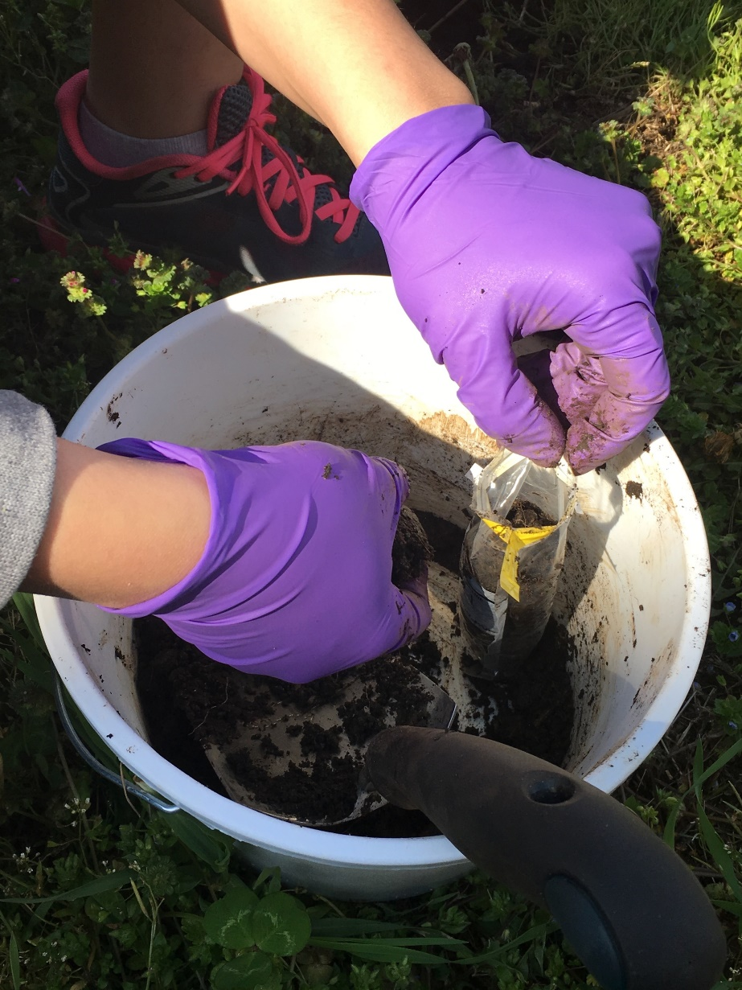
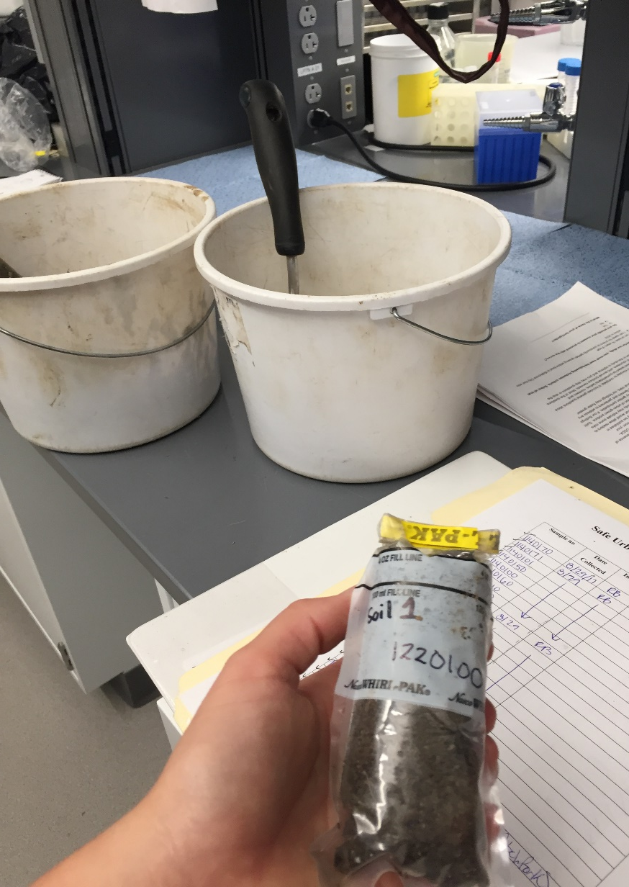
Soil sample collection
Non-growing area
  Collect one soil sample in heavily trafficked area close to growing area (mark “A” on map)
  Collect separate soil sample from area representing native soil conditions (mark “B” on map)
Compost
  If finished compost (e.g., does not contain visible remains of produce, leaves, etc.) is present on site, take a scoop and mark on “C” on map

Slide 23
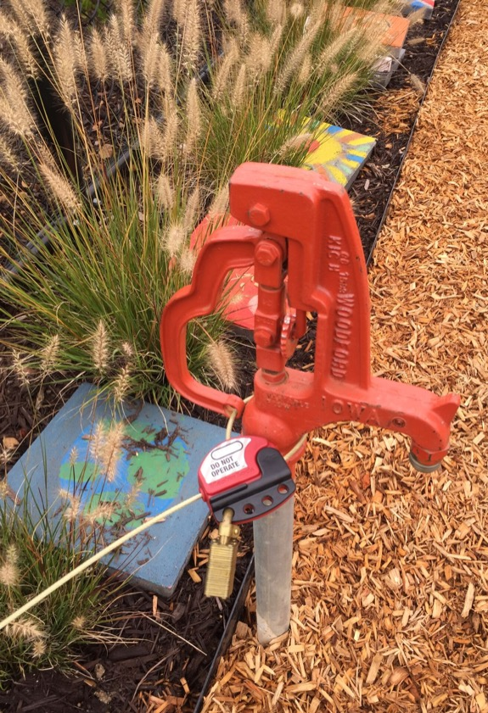
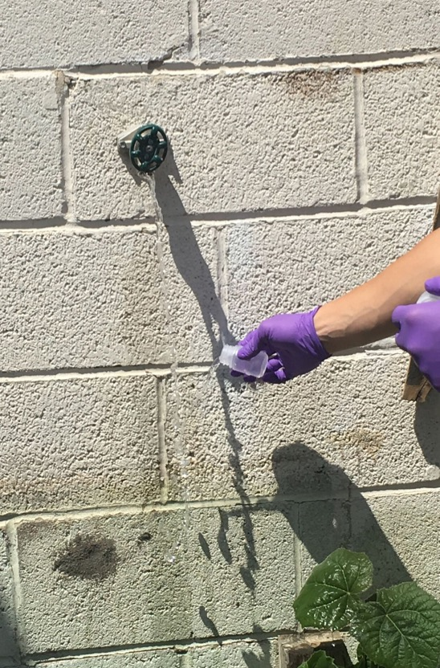
Water sample collection
If water source was located onsite, 1-3 samples were collected from each unique source
Obtain sample as close to source as possible without modifying set up
Flush for 30 seconds
Rinse bottle with running water
Fill full, and cap the bottle
Record location of water sources on map (1, 2, 3)

Slide 24
Leafy greens
Kale
Lettuce
Roots and tubers
Carrots
Fruiting nightshades
Tomatoes
Collards
Sweet potatoes
Potatoes
Beets
Peppers
Eggplant
Cucurbits
Summer squash
Cucumbers
Legumes
String beans and snap peas
Produce collection
Urban-grown: 248 samples (from 72 urban sites)
  >12 samples of each of the 13 varieties
  238 paired soil samples taken near spot where produce was harvested
Supermarket (from 22 stores):
  139 conventional samples
  130 organic samples
Farmers market: 132 samples (from 32 vendors)
Produce analyzed in study
Notes:
See supermarket and farmers market slides to come for full description of strategy

Slide 25
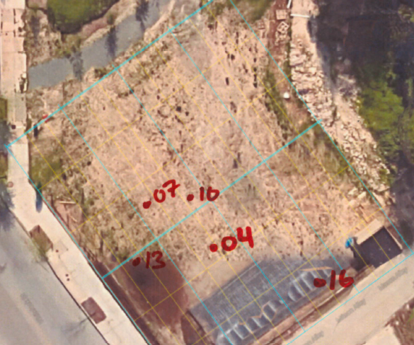
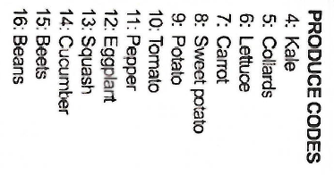
Urban produce sample collection
Harvest edible produce samples until minimum mass requirement is satisfied
  Take subsamples from >2 plants per produce item (with exception of very large and limited produce)
  Take soil subsample near each spot where produce item subsample was harvested
Record location harvested with corresponding produce code on map. Mark multiple spots if subsamples are taken from different areas.
Record mass of produce sample and number of plants/subsamples used to comprise composite sample.
Place all subsamples into prelabeled ZipLoc collection bag, remove the air, and seal bag
Reimburse garden $5/produce type harvested

Slide 26


Urban produce collection

Slide 27
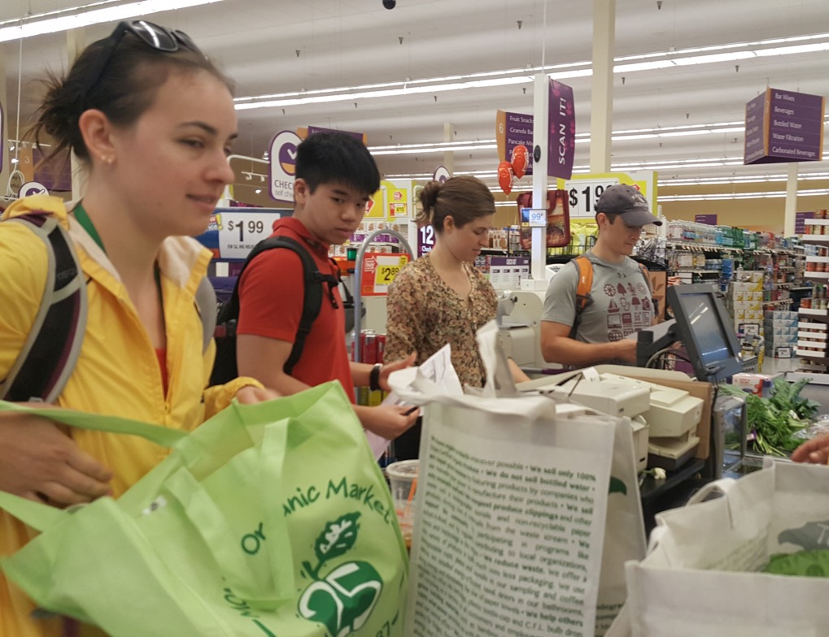

Supermarket produce collection
Notes:
Supermarket selection strategy: According to market research studies, food shoppers don’t necessarily shop according to geographic proximity but based on prices. Thus, we initially selected 10 grocery stores that represented a diversity of price ranges/SES markets. We included independent stores, chain supermarkets, and two international food stores.
For every produce item available at each grocery store, we purchased two composite sample equivalents (one USDA certified organic, and one conventionally produced)
When possible, we purchased ≥ 2 “subsamples” (e.g., two potatoes, two beets for each composite sample, even if 1 potato satisfies the minimum weight requirement.)
As only a few of the initial stores offered organic produce items, we had to expand our store search to include more higher-income stores that offered organic produce in order to reach our minimum of 10 organic samples per each produce item. We had to go to one store a few miles outside of city limits to get the last organic eggplant sample.

Slide 28

Farmers market produce collection
Notes:
Since many of the same vendors attend multiple different farmers markets, we kept track of which vendors from which we purchased each sample and did not buy the same produce item from the same vendor (even if they were at a different farmers market). There was no maximum number of produce types that could be purchased from an individual vendor - For example, if one vendor had all 12 produce items on the site checklist, we could purchase 12 composite sample from this single vendor.)
Vendor Eligibility:
We did NOT buy produce that is “certified organic.”
We did NOT buy produce from any vendor that is based in Baltimore City.
When possible, we purchased ≥ 2 “subsamples” (e.g., two potatoes, two beets for each composite sample, even if 1 potato satisfies the minimum weight requirement.)

Slide 29
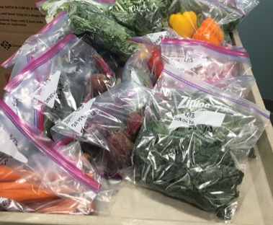
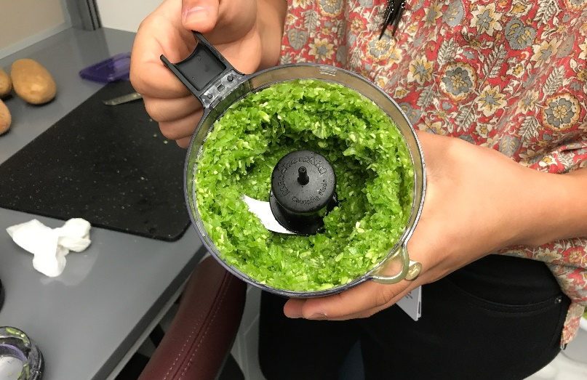
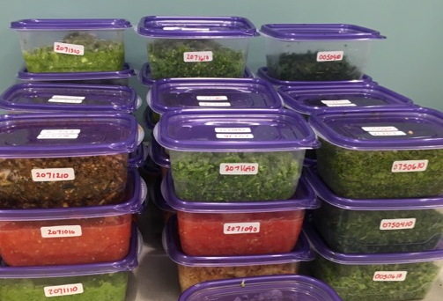
Produce sample preparation
In May 2017, conducted informal survey of >200 people about their produce washing and preparation habits. Used these results to develop protocol for handling each item. General approach:
  Rinse items: Hold each subsample under running deionized water for 5 seconds, moving item back and forth to wet entire surface. Remove visible dirt/debris.
  Dry greens using salad spinners; all other items shake and dry gently with towel
  After washing, peel carrots and beets
  Remove non-edible portions (stems, inedible bruises, etc.) then chop to fit into food processor
  Homogenize each item to between coleslaw and salsa consistency
  Transfer homogenized sample to storage container and put in freezer
  Record pre- and post-homogenization mass
  Wash all utensils with SLS and deionized water between processing samples
Aimed to wash and homogenize all produce samples within 24 hours of harvesting or purchasing (in some cases, it was 48-72 hours)
Notes:
Note: Some uncertainty around preparation protocol. Were we not to peel some root veggies, we may find higher metal concentrations; people may be exposed to more than what we find.
Fun anecdotes:
Most disgusting smelling raw, ground up sample: toss up between eggplant or collards
Most appetizing : tomatoes or carrots
Prettiest: beets

Slide 30
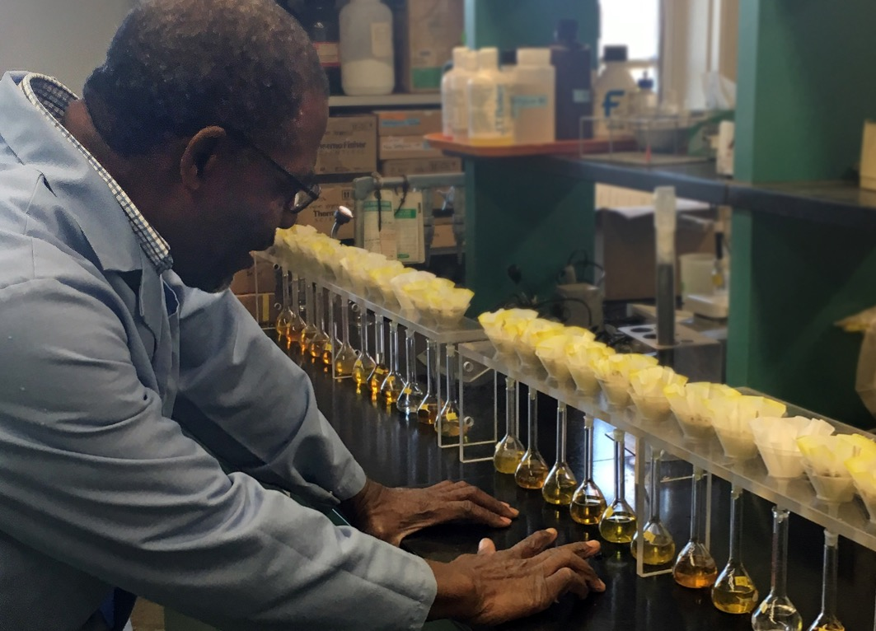
Sample analysis
  Toxic metals being tested for:
  Arsenic
  Barium
  Cadmium
  Chromium
  Copper
  Iron
  Lead
  Manganese
  Nickel
  Zinc
  Additional elements being tested for:
  Calcium
  Phosphorus
  Potassium
Notes:
Remind them we’re not testing for microbes in water, several soil nutrients of interest to gardeners (e.g. SOC)

Slide 31
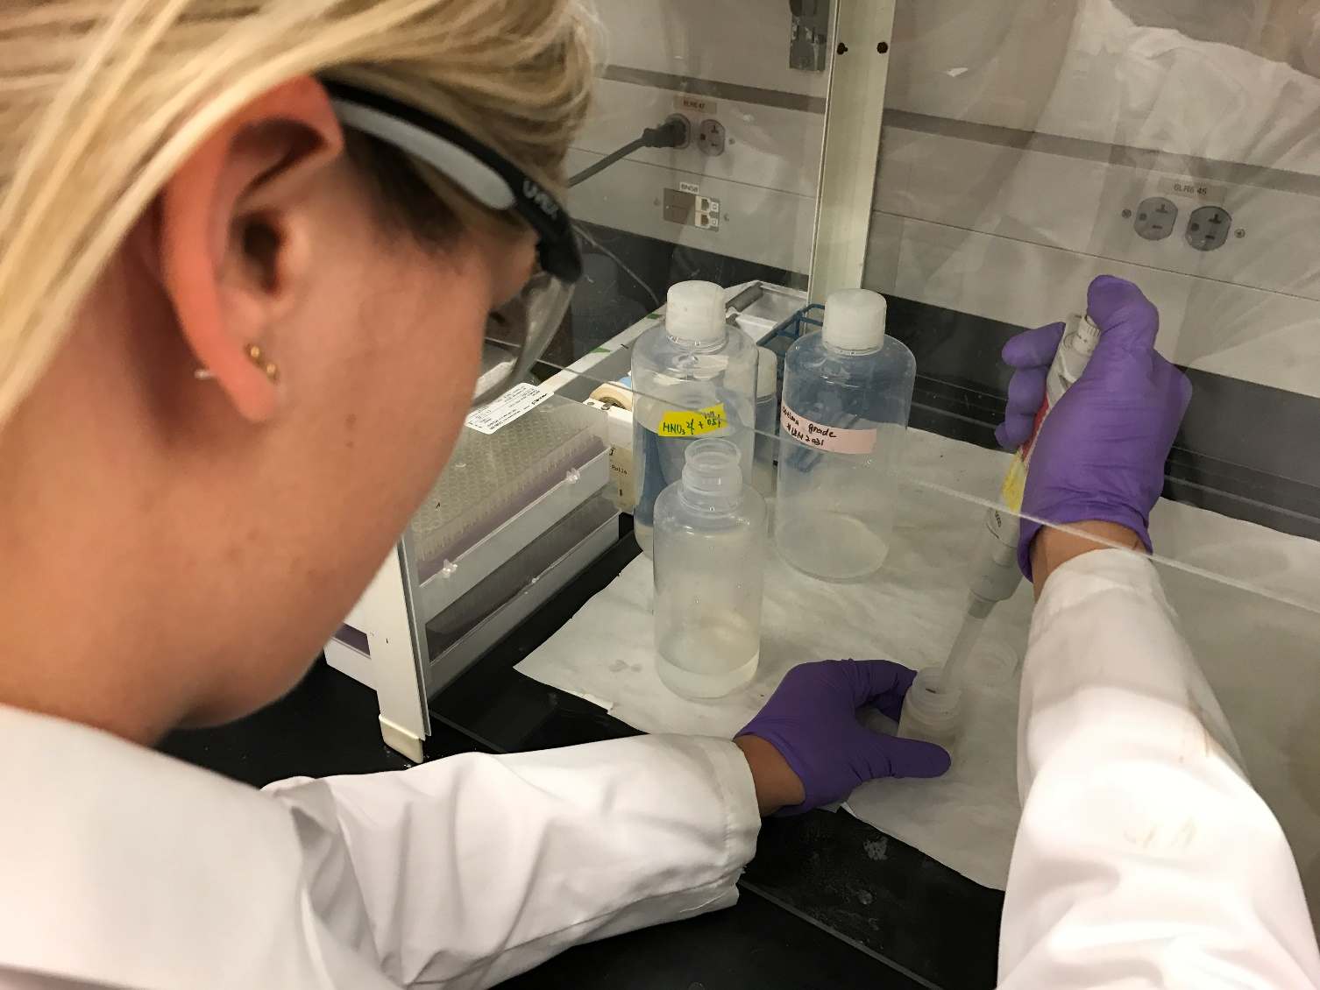
Water sample processing and analysis
  Sample processing:
  Acidification overnight to kill microbes and dissolve solids
  Analytical measurement:
  Inductively Coupled Plasma – Mass Spectrometry (ICP-MS)
With the support of Ana Rule’s lab at Johns Hopkins School of Public Health

Slide 32
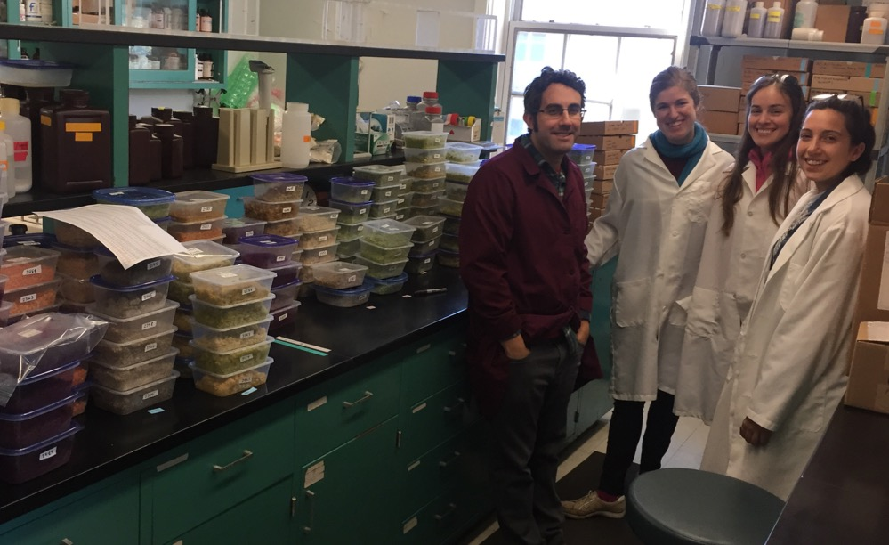
Soil and produce sample processing and analysis
With support of our partners at USDA Agricultural Research Service, Adaptive Cropping Systems Laboratory

Slide 33
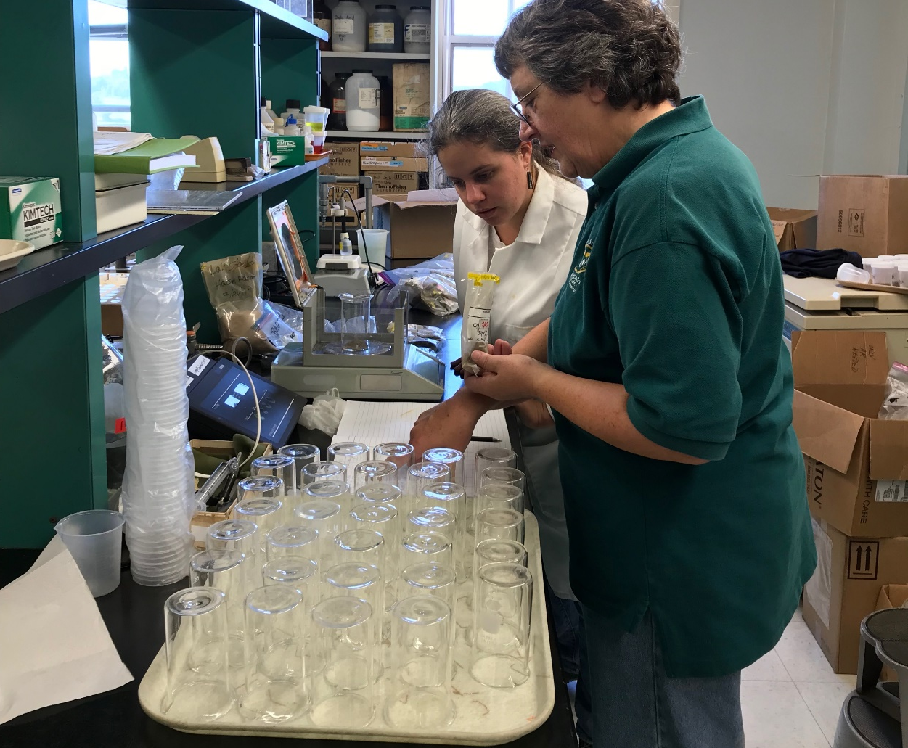
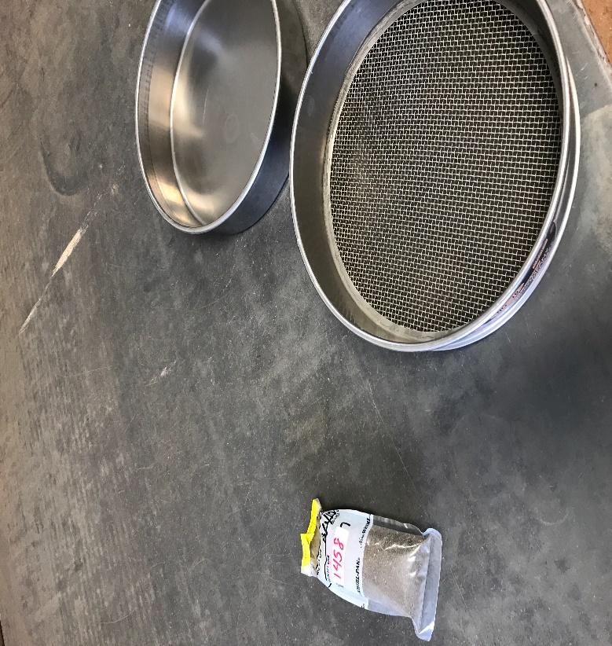
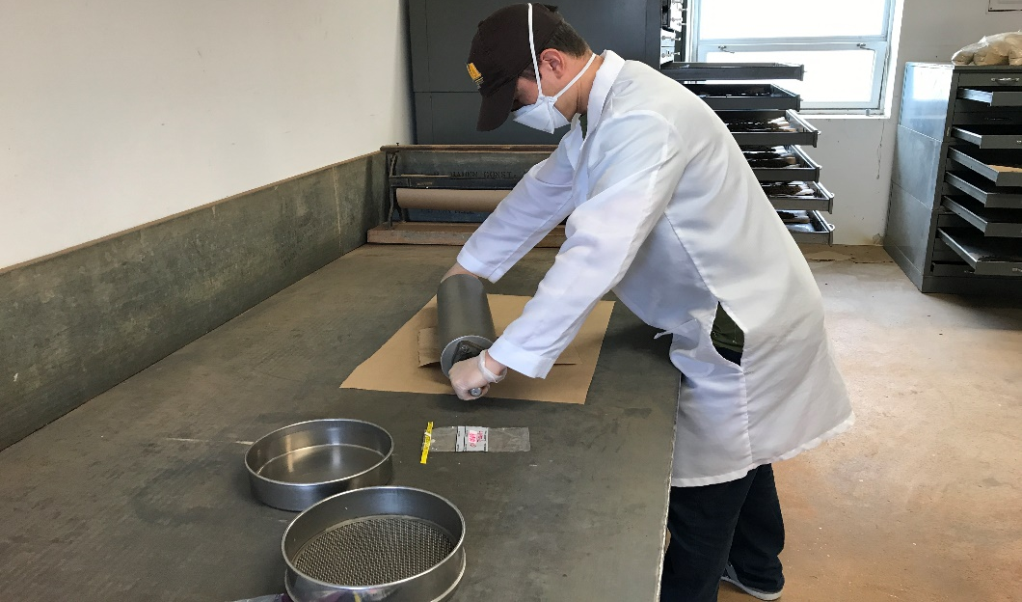
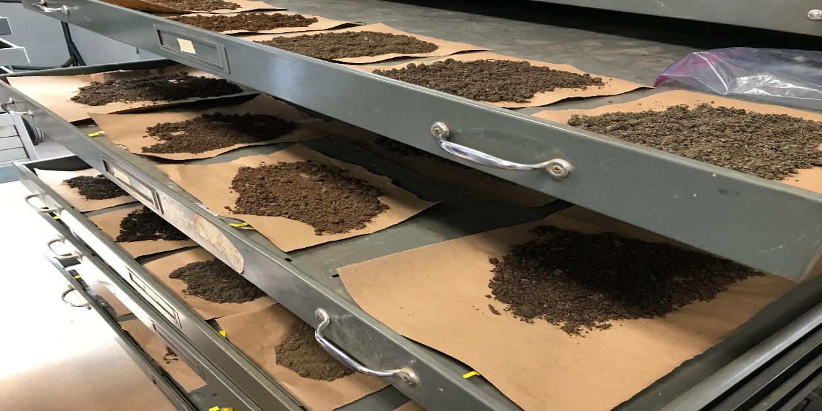
Soil sample processing
Thaw and dry frozen soil sample
Crush soil particles
Sieve each sample to remove large pieces/debris
Weigh samples

Slide 34
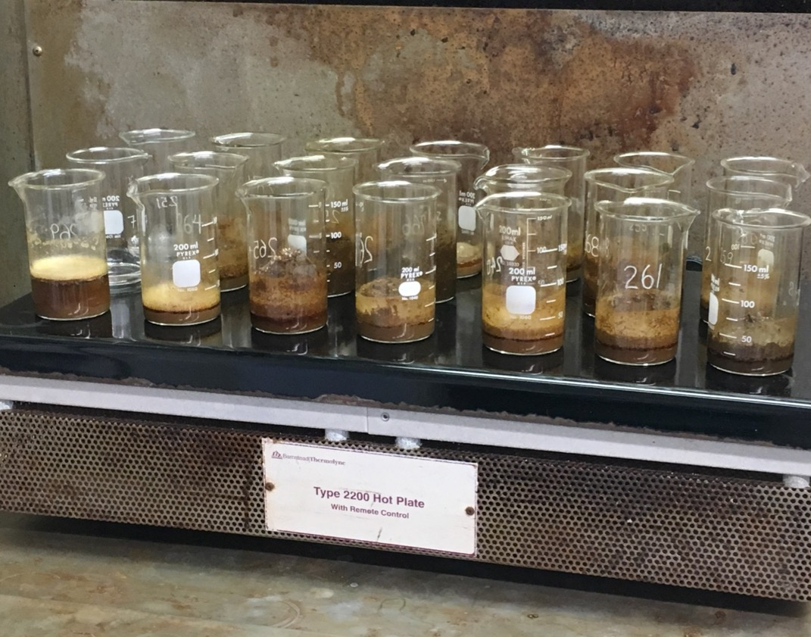
Soil sample analysis - methods
Digestion methods:
Aqua regia: determine total* concentration of metals in sample
Diethylenetriaminepentaacetic acid (DTPA): determine available concentrations of metals for uptake into plants
Analytical measurement:
Inductively Coupled Plasma – Optima: measurement of elemental concentrations in solution

Slide 35
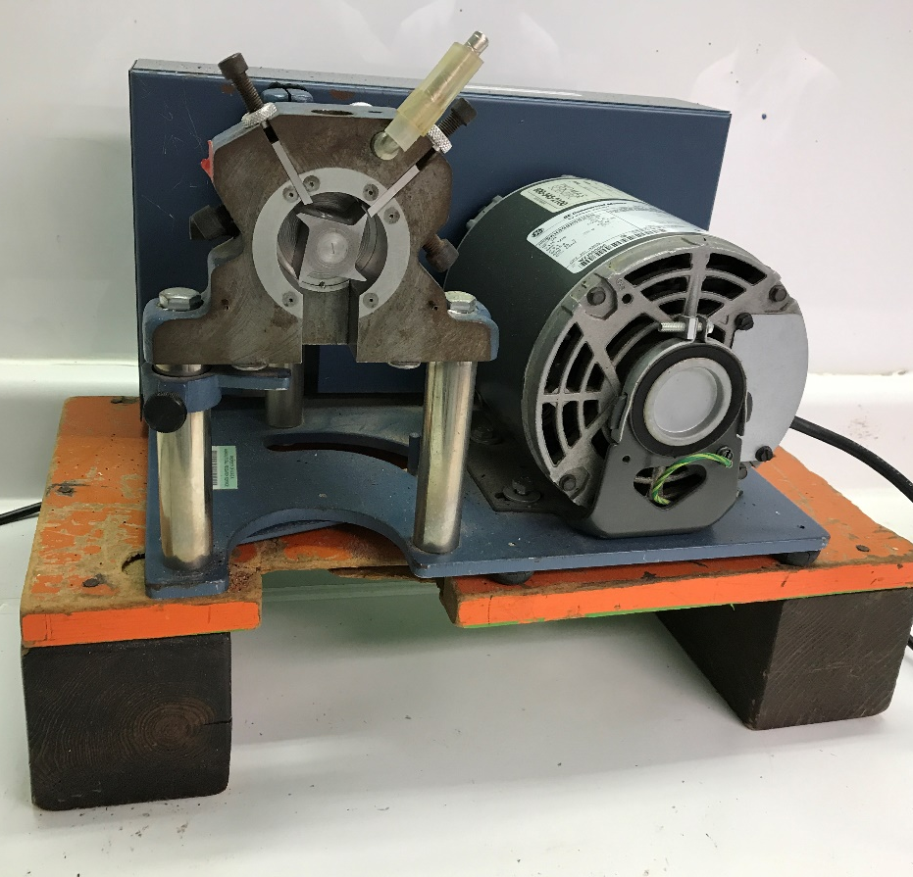
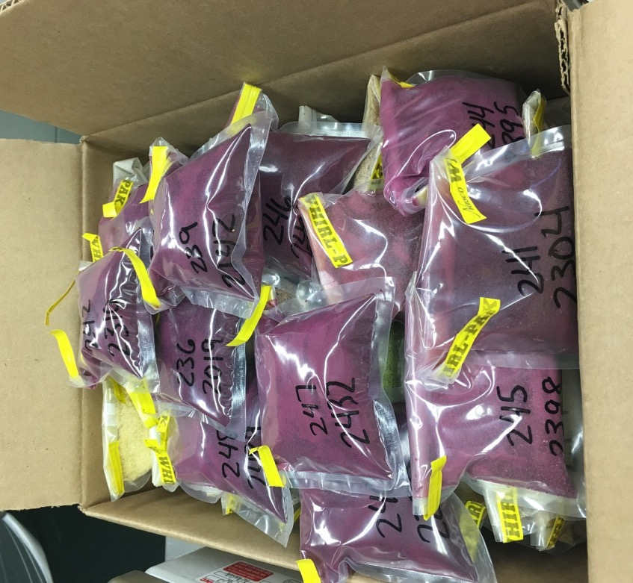
Produce sample processing
Dry frozen, homogenized sample
Grind in Wiley mill
Wet masses recorded pre- and post-homogenization and dry masses recorded prior to grinding

Slide 36
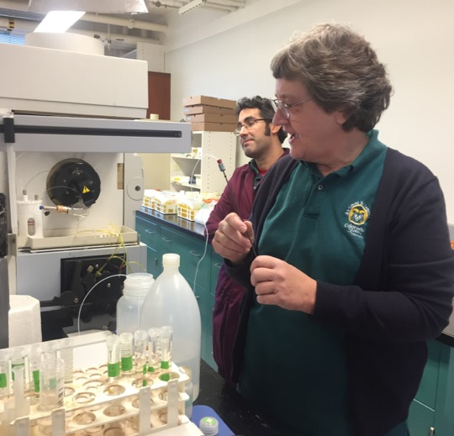
Produce sample analysis - methods
Digestion methods:
Microwave digestion with nitric acid
Analytical measurement:
Inductively Coupled Plasma – Optima: measurement of elemental concentrations in solution

Slide 37
Overview
Motivation
Aims
Methods
Preliminary results
Survey
Water

Slide 38
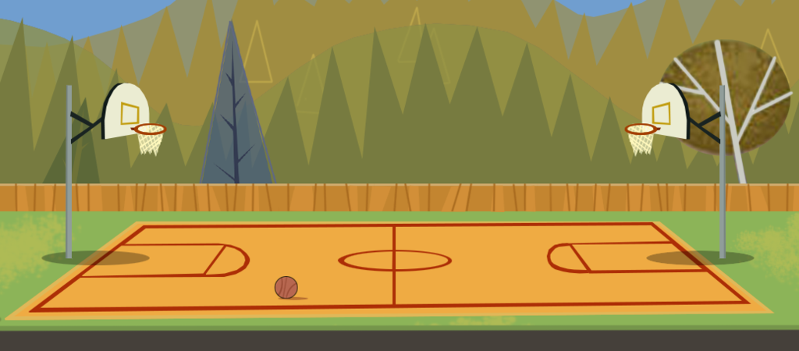
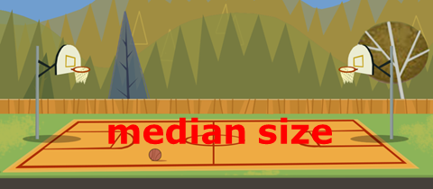

Garden/farm size
Common row house lot size: 1250 – 1500 sq ft
N = 118
mean size
Notes:
The mean size is 11,800 square feet, a little bit larger than a quarter acre, about the size of 2.5 basketball courts and the median is 4000 square feet, about the size of 1 basketball court.
Keep in mind that this includes things like walkways, toolsheds and picnic areas and not necessarily just growing space

Slide 39
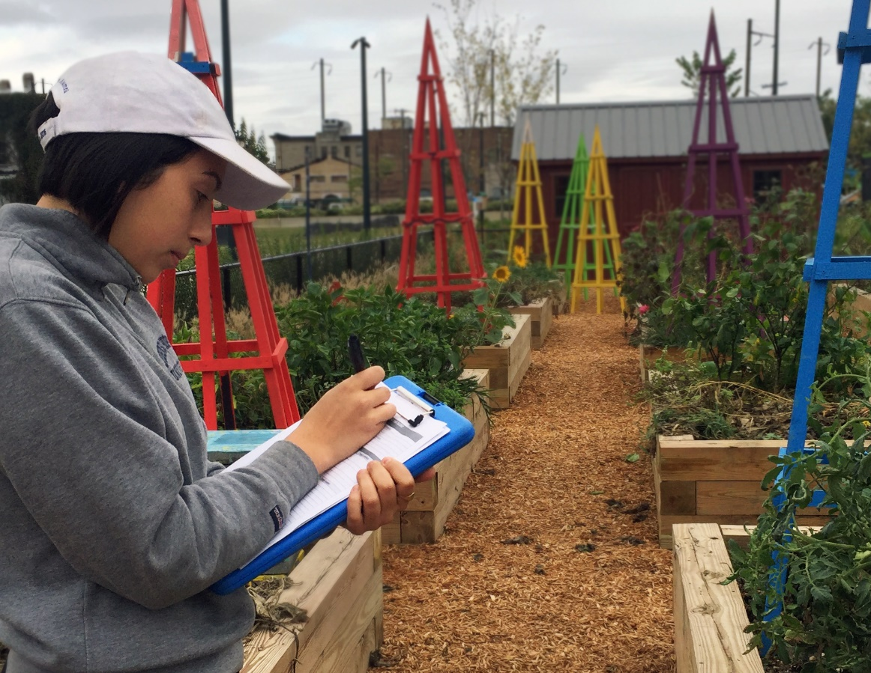
Notes on preliminary survey data
Answers are self-reported; we cannot guarantee veracity
Some participants who filled out surveys have not participated in garden since its inception and thus did not know full site history, soil testing history, soil and compost sources, etc.
118 total surveys analyzed
  Includes the 112 eligible site participants plus 6 additional sites we sampled that were just outside city limits or not yet growing food

Slide 40
Year established
N = 118
Changing hands
History not always known
Garden “re-start”
Notes:
12 participants either didn’t know or didn’t include a response. From the participants who we spoke to over the phone, it was fairly common to take over a site from a previous manager and not know the full history of the site. This also presents a space for potential misunderstanding – some sites might have been established over a garden that once existed there but had closed & some participants were unsure if this question was asking for the date the current garden was established of if the land it was on had been converted to a garden

Slide 41
Access to site
N = 118
Site access | Count
Private, Non-Commercial Property | 41.5
Adopt-A-Lot Program | 31
City Property | 27.5
Gardener's Personal Property | 12
Business Property | 1
Unknown to gardener | 2
No response | 3
N | 118
Notes:
Adopt a lot is city property, but they are listed separately because of the number of participants that sited it specifically; other gardens were on city property through other means. Adopt a Lot is a program that allows community members to “adopt” Baltimore City-owned vacant lots to improve and use as community open spaces. Interested parties must submit a special application and, if accepted, sign a legally binding license agreement with the Mayor and City Council of Baltimore, giving it access to and possession of the lot for a period of one year. The license agreement is renewable.
The other forms of city property (the 23% segment) that gardens are on include City Parks and Recreation parcels of land and land owned by a Baltimore city public school.
Baltimore Green Space land trusts – only 2 participants cited this & from my understanding it doesn’t give us any indication as to who actually owns the land

Slide 42
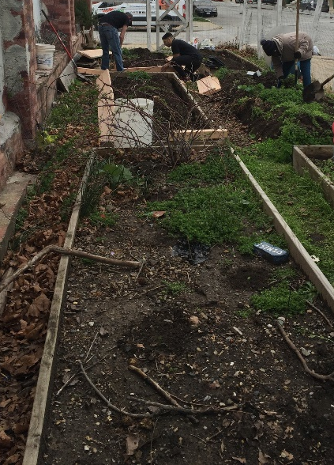
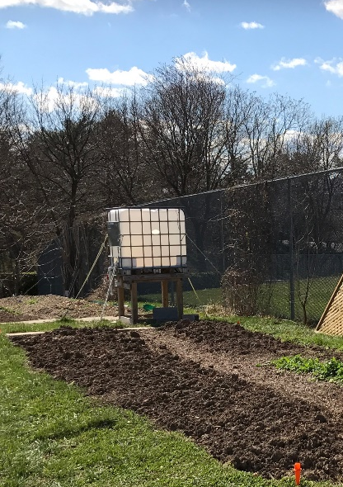
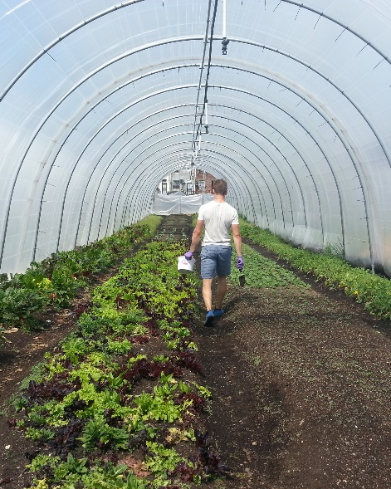
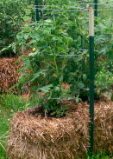
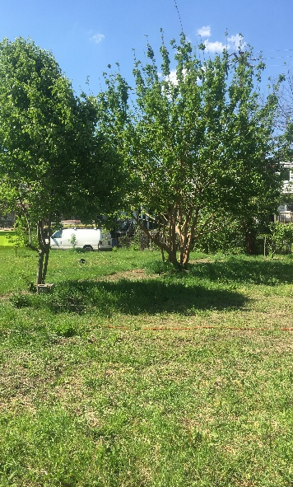
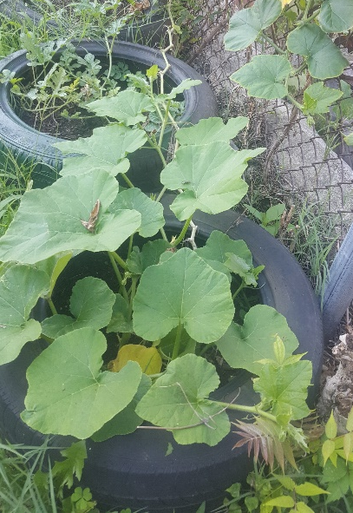
Modes of production
N = 118
*answers not mutually exclusive
Notes:
We asked participants where/by what methods they grew produce: Across all farms/gardens in our sample, over half of participants reported that they used framed raised beds to grow produce
These were the options that participants could choose in the survey
Framed raised beds different from open-raised just in that they have a frame of wood or another material – both have imported soil mounded on top of ground
We don’t know what “modes” were used inside of hoophouses or greenhouses
Non-edible vegetation includes perennials, flowers, trees, etc.
Container could mean pot or tire

Slide 43
Use of imported growing medium (soil, compost)
Most common sources or types reported of imported soil
Source | No. of farms or gardens
Chesapeake Compost Works | 23
Veterans Compost | 12
Home Depot | 11
Camp Small - City-owned wood entrerprise to reduce city's waste | 11
Hollins Organic Products, Inc. | 10
Local vendors (gardening stores, nursery, hardware store) | 10
Manure (horse, cow) | 9
Mushroom compost | 9
Compost (from various sources) | 8
Lowes, Walmart, or other big box store | 5
Donation, unknown source | 5
Edrich Lumber | 4
Parks & People/CGRN | 4
A&E Enviromental Services | 3
Mulch from various sources | 3
N = 118
*answers not mutually exclusive
Notes:
The chart on the right is those who responded Yes to the question displayed in the pie chart on the left

Slide 44
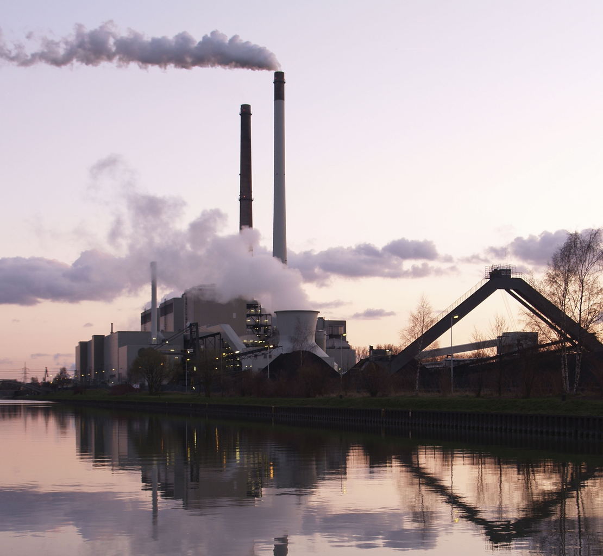
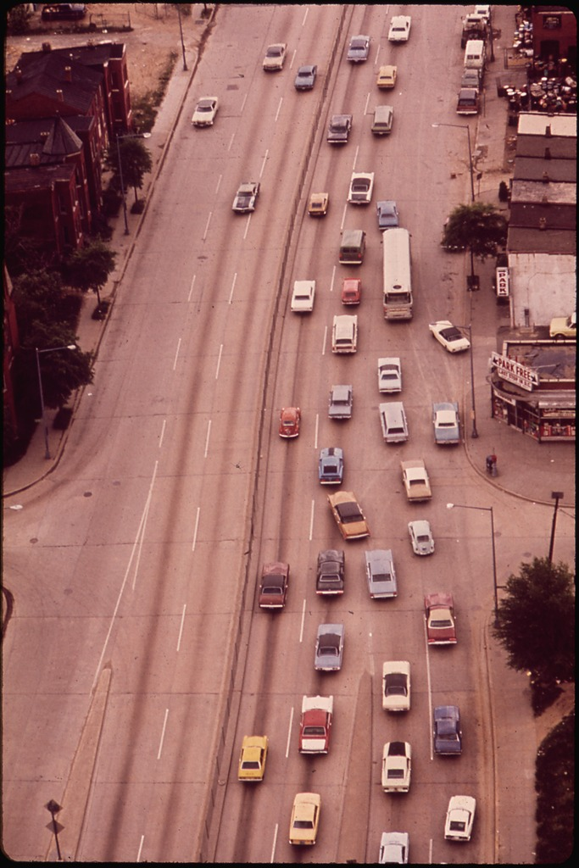
Reported potential sources of contamination
Potential source of contamination | Percentage of sites reporting
None | 11%
Building demolition on-site or nearby | 21%
Illegal dumping | 14%
Industrial activity on-site or nearby | 6%
Fire on site or nearby | 5%
Heavily trafficked roadway | 5%
Herbicide use nearby | 5%
Nearby hazardous waste | 2%
Pesticide use nearby | 2%
Other | 6%
Unknown source of lead or heavy metals contamination | 5%
Unknown (whether any contamination) | 6%
No response | 26%
N = 118
*answers not mutually exclusive

Slide 45
Previous contaminant tests
Most recent soil test
Previous contaminant tests | No. of sites
Soil | 64
Water | 6*
Produce | 0
*3 of water tests were just public municipal tests with the results available online; 2 sites didn’t know where water was tested and 1 listed Hague Quality Water of MD (filter company)
N = 118

Slide 46
Soil previously tested for… (responses)
N = 118
*answers not mutually exclusive

Slide 47
Barriers to testing
N = 118
Notes:
Note that many people mentioned that they knew about soil testing but had never considered or didn’t know how/where you get water and produce testing
*2 knew how to conduct soil but not water or produce testing
^2 hadn't considered testing for contaminants (only tested nutrients); 1 hadn't considered testing produce or water
Other: includes lack of interest, trying not to disturb soil and site-specific logistical challenges

Slide 48
Did results prompt behavior change?
N = 118
Notes:
I kept in the “remove gardening gear when entering home” even though no one selected that option because I thought it was interesting that literally no one did that

Slide 49

Challenges in characterizing human activity
The following slides explore human activity on each site, which will be used to calculate risk associated with growing and consuming urban produce given the contaminant data we collected
It is difficult to categorize different types of garden participation. We broke into two categories:
  Regular participants (e.g., staff, interns, garden members, and their household members)
  Infrequent and one-time visitors (e.g., people who come for event, volunteer day, field trip)
Participants struggled with answering these survey questions for several reasons:
  Categorization of regular participants and infrequent visitors was confusing to many
  Differences in participant formality and social structures across sites
  Participant activity changes dramatically across growing season (e.g., more frequent in summer than in spring or fall)
  Most sites do not track these variables
Participant challenges + Recall bias -> uncertainties with this data
$$ADD= \frac{C∗IR∗EF}{BW}$$

Slide 50
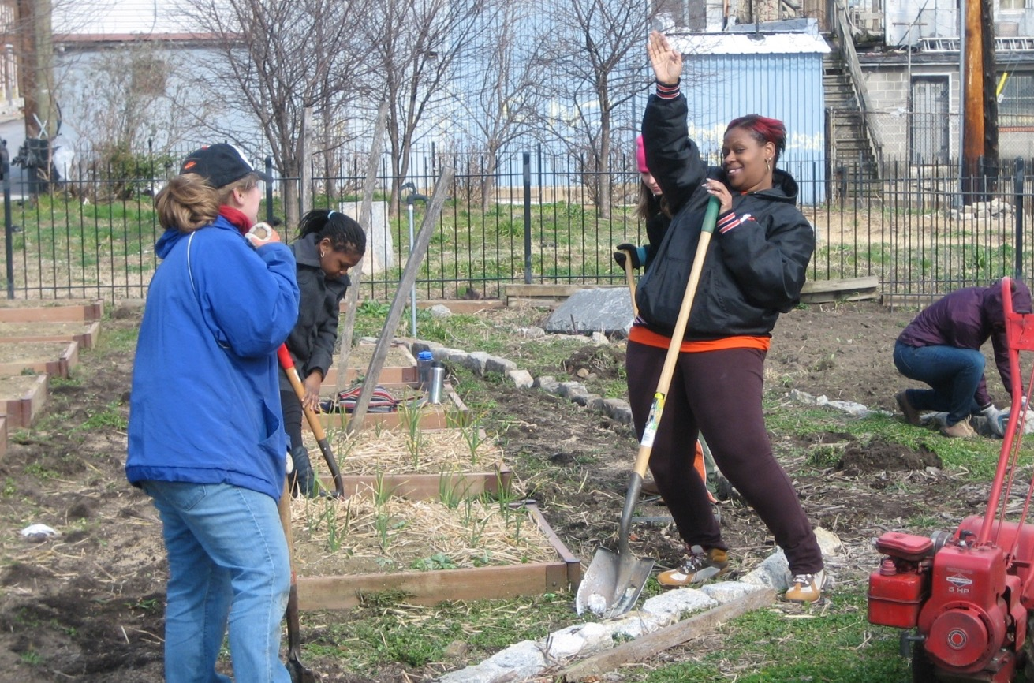
Average # of participants per site per age group
Age group | Average no. of participants/site | N
Adult (18+ years of age) | 32.6 | 110
Youth (6-17 years of age) | 23.4 | 81
Child (<6 years of age) | 4.5 | 72
Notes:
“On average, a random farm in our sample had 33 regular adult participants in 2016”
Note: will need to go back into Qualtrics and see how many sites that didn’t respond were ones that never received this question

Slide 51
Time per visit (regular participants)
Average time spent per visit | Hours | N
Adult (18+ years of age) | 2.5 | 102
Youth (6-17 years of age) | 1.5 | 62
Child (<6 years of age) | 1.3 | 52

Slide 52
Soil contact per visit (proportion)
DIRECT soil contact: planting, harvesting, weeding, applying compost, building hoophouses, playing directly in soil, etc.
INDIRECT soil contact: watering plants, painting signs, leading tours, playing tag , etc.
NO soil contact: paperwork, meetings, etc.

Slide 53
Number of infrequent, one-time visitors
N=118

Slide 54
Time per visit (infrequent visitors)
Average: 2.1 hours/visit (N=97)

Slide 55
Overview
Motivation
Aims
Methods
Preliminary results
Survey
Water

Slide 56
Irrigation water (as observed)
*answers not mutually exclusive
Notes:
Interesting side note: one gardener picked up a bacterial infection (H. Pylori) from contaminated water at the site

Slide 57
Water samples collected
235 Water samples collected and analyzed from 93/118 (79%) sites visited
121 Primary samples (duplicates available for 116)
Water source | N (%)
Municipal | 93 (77%)
Barrel | 21 (17%)
Other* | 7 (6%)
Total | 121
Collection point | N (%)
Hose | 42 (35%)
Spigot | 32 (27%)
Other^ | 4 (3%)
Not Recorded | 43 (35%)
Total | 121
*Includes municipal stored in barrels or tanks; also aquaponics system (combination of municipal and barrel sources)
^ e.g., combination (e.g., spigot on hose) or indoor sink
Notes:
116 primary samples have duplicates – not reported/analyzed for this presentation (we hoped to have duplicate of every primary sample, but that didn't always happen in reality. Duplicates were sometimes missed for the second/third sample)
“Not recorded” means we didn't log it. Primary observation of interest was source - Point helps us remember site set up and which sample was which.
We collected two water samples at FSL - one was from a municipal source used to fill the tanks. The other was from the aquaponics tanks.

Slide 58
Summary
All mean concentrations < USEPA drinking water MCLs or guidelines
5 elements did not have a single sample that exceeded the drinking water guideline
Arsenic
Barium
Cadmium
Chromium
Copper
Iron
Lead
Manganese
Nickel
Zinc
Notes:
100 primary samples < LOD

Slide 59
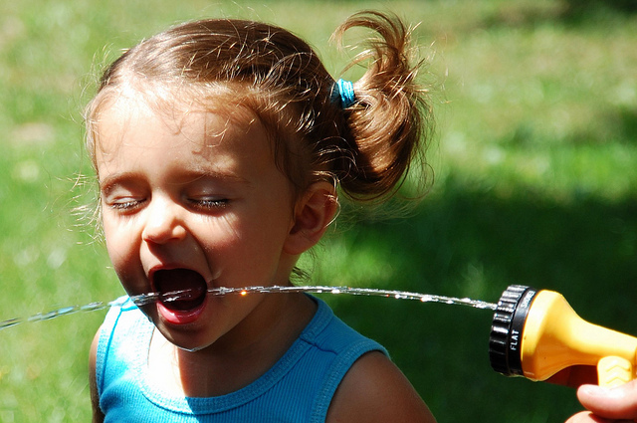
Note on Interpretation
Currently no federal guidelines or regulations for metals in water used for irrigation.
Photo credit: Mim (CC BY-ND 2.0)

Slide 60
Note on Interpretation
Guideline | Source | Rationale | Elements
Primary Maximum Contaminant Level (MCL) | US EPA’s Safe Drinking Water Act | Health-based | Arsenic (10 ppb) Barium (2,000 ppb) Cadmium (5 ppb) Chromium (100 ppb) Nickel (100 ppb)
Secondary Maximum Contaminant Level (SMCL) | US EPA’s Safe Drinking Water Act | Aesthetic | Iron (300 ppb) Manganese (50 ppb) Zinc (5,000 ppb)
Action Level (AL) | US EPA’s Lead and Copper Rule | Health-based | Copper (1,200 ppb) Lead (15 ppb)
Notes:
100 primary samples < LOD

Slide 61
Preliminary Water Results – Arsenic
Arsenic (ppb)
 | All Sources (n=121) | Municipal (n=93) | Barrel (n=21) | Other (n=7)
Average | 0.31 | 0.24 | 0.46 | 0.71
Median | 0 | 0 | 0 | 0
95th Percentile | 1.84 | 1.84 | 1.13 | 4.96
Max | 6.96 | 4.43 | 6.96 | 4.96
Number below LOD (0.157ppb) | 100 | 78 | 16 | 6
Number above MCL (10 ppb) | 0 | 0 | 0 | 0
Notes:
100 primary samples < LOD

Slide 62
Preliminary Water Results – Cadmium
Cadmium (ppb)
 | All Sources (n=121) | Municipal (n=93) | Barrel (n=21) | Other (n=7)
Average | 0.09 | 0.11 | 0.04 | 0.02
Median | 0 | 0 | 0 | 0
95th Percentile | 0.23 | 0.29 | 0.11 | 0.13
Max | 6.93 | 6.93 | 0.66 | 0.13
Number below LOD (0.007ppb) | 106 | 83 | 17 | 6
Number above MCL (5ppb) | 1 | 1 | 0 | 0
Notes:
106 primary samples < LOD

Slide 63
Preliminary Water Results – Iron
Iron (ppb)
 | All Sources (n=121) | Municipal (n=93) | Barrel (n=21) | Other (n=7)
Average | 409.13 | 477.14 | 170.43 | 221.61
Median | 60.22 | 58.15 | 60.22 | 76.76
95th Percentile | 945.74 | 945.74 | 404.49 | 1197.17
Max | 26,789.59 | 26,789.59 | 1015.46 | 1197.17
Number below LOD (0.120ppb) | 1 | 1 | 0 | 0
Number above SMCL (300 ppb) | 21 | 15 | 5 | 1
Notes:
1 primary sample < LOD

Slide 64
Preliminary Water Results – Lead
Lead (ppb)
 | All Sources (n=121) | Municipal* (n=93) | Barrel* (n=21) | Other (n=7)
Average | 4.90 | 3.91 | 10.11 | 2.48
Median | 0.57 | 0.45 | 0.87 | 0.30
95th Percentile | 115.94 | 39.68 | 46.61 | 13.97
Max | 160.51 | 160.51 | 115.94 | 13.97
Number below LOD (0.005ppb) | 15 | 13 | 0 | 2
Number above AL (15ppb) | 7 | 4 | 3 | 0
Notes:
15 Samples <LOD

Slide 65
Preliminary Water Results – Manganese
Manganese (ppb)
 | All Sources (n=121) | Municipal (n=93) | Barrel (n=21) | Other (n=7)
Average | 14.42 | 13.82 | 20.74 | 3.36
Median | 5.08 | 5.08 | 12.55 | 2.47
95th Percentile | 58.90 | 58.90 | 70.49 | 8.28
Max | 292.62 | 393.62 | 93.71 | 8.28
Number below LOD (0.025ppb) | 0 | 0 | 0 | 0
Number above SMCL (50 ppb) | 7 | 5 | 2 | 0

Slide 66
Preliminary Water Results – Zinc
Zinc (ppb)
 | All Sources (n=121) | Municipal (n=93) | Barrel (n=21) | Other (n=7)
Average | 200.97 | 221.87 | 124.99 | 151.23
Median | 30.87 | 24.60 | 80.68 | 53.81
95th Percentile | 680.30 | 874.01 | 428.05 | 482.83
Max | 6,090.39 | 6,090.39 | 629.68 | 482.83
Number below LOD (0.490) | 6 | 5 | 0 | 1
Number above SMCL (5,000ppb) | 1 | 1 | 0 | 0
Notes:
6 primary samples < LOD

Slide 67
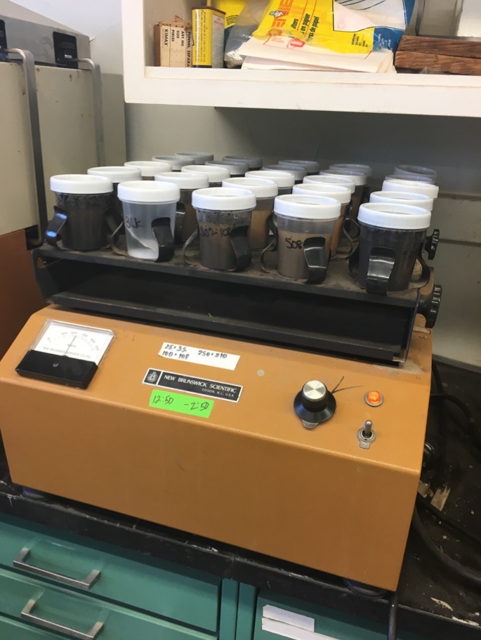
What’s next?
Soil and produce samples being processed and analyzed
Soil and water results to be returned to participants by February/March 2018
Produce results to be completed by June
Chicago comparative analysis to be completed by summer 2018

Slide 68
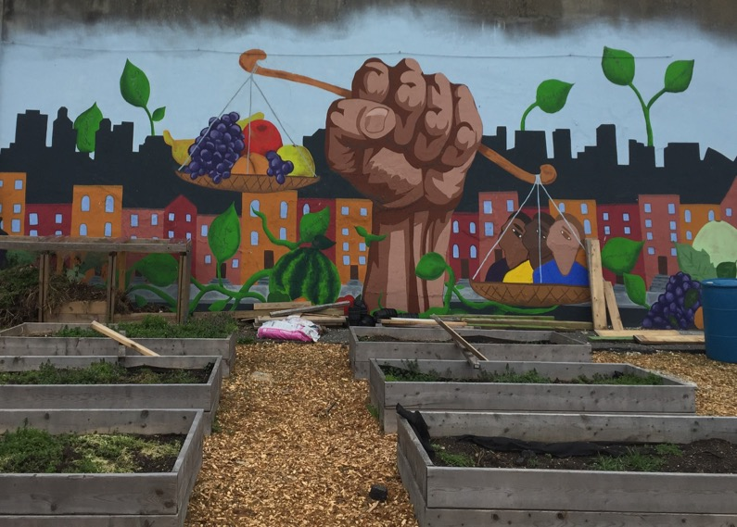
Reporting back to the community
  Critical priority: results (especially site-specific) are conveyed in an understandable, useful and actionable manner to participants
  To determine health risk associated with growing and consuming urban produce, we will compare results to:
    EPA regional soil screening levels
    EPA drinking water standards (MCLs, SMCLs)
    WWEIA-Food Commodity Intake Database
  We will provide “options” of behavioral, environmental, and consumption changes that can reduce exposure (and thus health risk)
  We can’t, however, tell gardeners what to do. Safety is subjective.

Slide 69
Future directions
Assessment of urban farm participant microactivity and impact on exposure estimation
Other contaminants (PAHs, legacy pesticides)
With NRCS - Comparison of measurement methodologies (XRF/in-situ vs. laboratory-based) for purposes of decision-making
Comparative analyses of nutrient content

Slide 70
Safe Urban Harvests Team
JHU Center for a Livable Future
Keeve Nachman, PhD, MHS
Ruth Burrows, MHS
Eleanor Evans
Jim Huang
Jotham Illuminati
Brent Kim, MHS
Sara Lupolt, MPH
Raychel Santo, MSc
Audrey Swanenburg
Colleen Synk, MSPH
Rachel Viqueira, MHS
USDA ARS
Eton Codling, PhD
Carrie Green, PhD
JHSPH - EHE
Rui Chen
Ana Rule, PhD
University of Illinois at Chicago
Molly Doane, PhD
Bianca Lopez, PhD
Emily Minor, PhD
Alexis Smith
Community Partners
Abby Cocke, Baltimore Office of Sustainability
Neith Little, University of Maryland Extension ⎯ Baltimore City
Valerie Rupp, Parks & People Foundation
Mariya Strauss & Crystal Forman, Farm Alliance of Baltimore

Slide 71

Questions?
#SafeUrbanHarvests
  @LivableFuture
  @keeve_nachman

Slide 72
Preliminary Water Results – Barium
Barium (ppb)
 | All Sources (n=121) | Municipal (n=93) | Barrel (n=21) | Other (n=7)
Average | 29.18 | 31.82 | 18.86 | 25.08
Median | 31.86 | 34.26 | 15.12 | 24.74
95th Percentile | 43.62 | 43.63 | 47.91 | 36.35
Max | 64.40 | 64.40 | 49.37 | 36.35
Number below LOD (0.061) | 0 | 0 | 0 | 0
Number above MCL (2,000 ppb) | 0 | 0 | 0 | 0

Slide 73
Preliminary Water Results – Chromium
Chromium (ppb)
 | All Sources (n=121) | Municipal (n=93) | Barrel (n=21) | Other (n=7)
Average | 0.33 | 0.22 | 0.65 | 0.80
Median | 0.72 | 0.03 | 0.21 | 0.16
95th Percentile | 1.81 | 1.12 | 1.81 | 2.63
Max | 7.04 | 4.52 | 7.04 | 2.63
Number below LOD (0.041) | 47 | 40 | 4 | 3
Number above MCL (100 ppb) | 0 | 0 | 0 | 0
Notes:
47 primary samples <LOD

Slide 74
Preliminary Water Results – Copper
Copper (ppb)
 | All Sources (n=121) | Municipal (n=93) | Barrel (n=21) | Other (n=7)
Average | 119.39 | 144.84 | 40.65 | 17.39
Median | 35.88 | 37.23 | 37.29 | 8.83
95th Percentile | 602.09 | 831.81 | 99.97 | 67.53
Max | 1260.89 | 1260.89 | 121.10 | 67.53
Number below LOD (0.037) | 0 | 0 | 0 | 0
Number above AL (1,300 ppb) | 0 | 0 | 0 | 0

Slide 75
Preliminary Water Results – Nickel
Nickel (ppb)
 | All Sources (n=121) | Municipal (n=93) | Barrel (n=21) | Other (n=7)
Average | 1.68 | 1.87 | 0.76 | 1.90
Median | 0.38 | 0.36 | 0.55 | 0.57
95th Percentile | 7.19 | 7.79 | 1.81 | 10.50
Max | 35.10 | 35.11 | 3.05 | 10.50
Number below LOD (0.038) | 9 | 6 | 2 | 1
Number above MCL (100 ppb) | 0 | 0 | 0 | 0
Notes:
9 Primary samples < LOD

